Slide 1


Slide 2


Slide 3
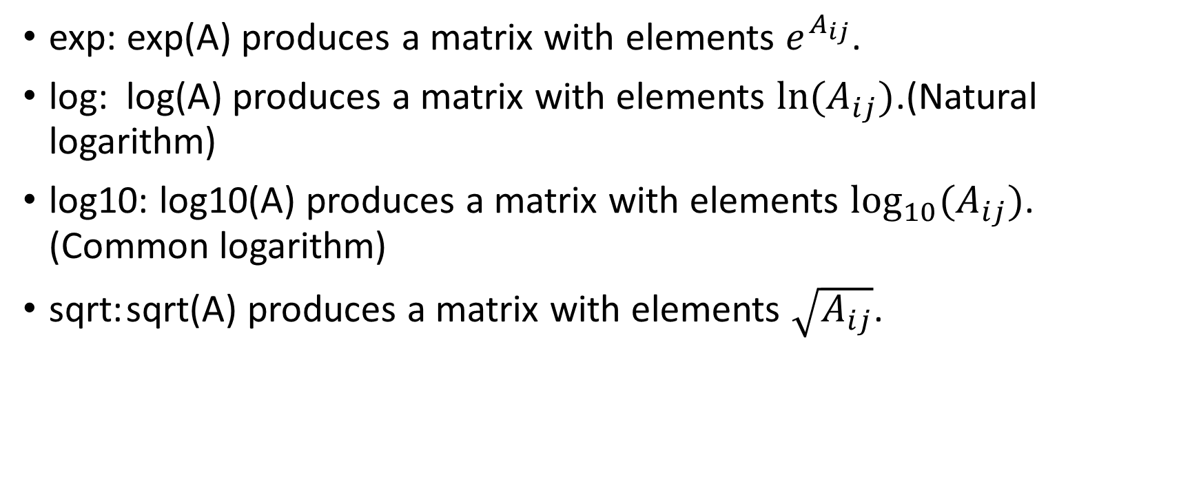
Exponential Functions
exp: exp(A) produces a matrix with elements $e^{A_{ij}}$.
log: log(A) produces a matrix with elements $ln⁡(A_{ij})$.(Natural logarithm)
log10: log10(A) produces a matrix with elements $\log_{10}{(A_{ij})}$. (Common logarithm)
sqrt: sqrt(A) produces a matrix with elements $\sqrt{A_{ij}}$.

Slide 4
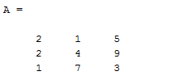
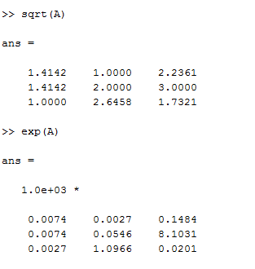
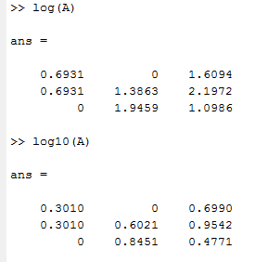

Slide 5

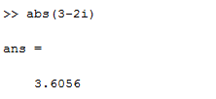
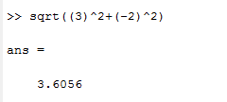

Complex Functions
$$abs\left(3−2i\right)=\sqrt{{\left(3\right)}^{2}+{\left(−2\right)}^{2}}$$

Slide 6

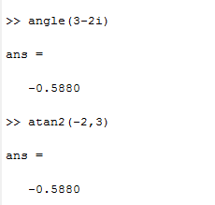

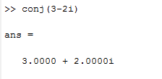

Slide 7

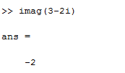
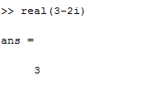

Slide 8

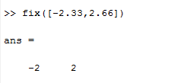
Round-off Functions

Slide 9

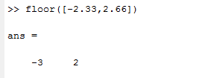
Round-off Functions

Slide 10

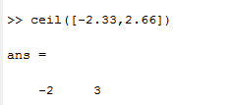
Round-off Functions

Slide 11
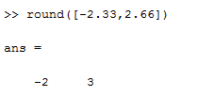
Round-off Functions

Slide 12


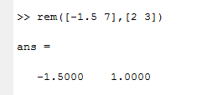
Round-off Functions

Slide 13

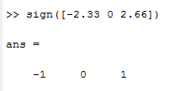
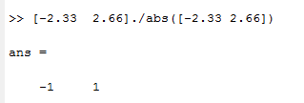
Round-off Functions

Slide 14
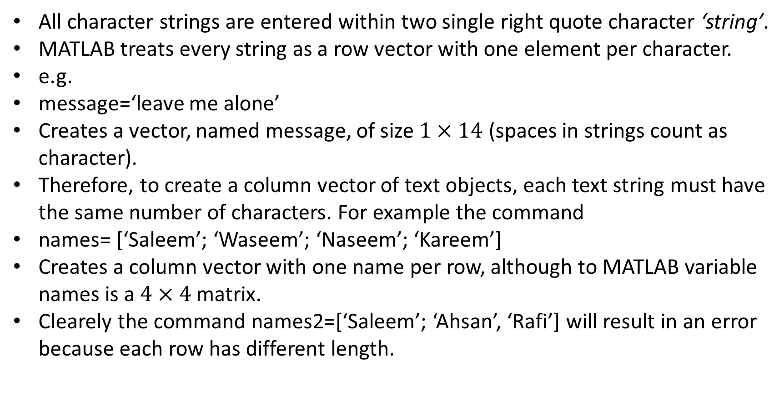
Character Strings
All character strings are entered within two single right quote character ‘string’.
MATLAB treats every string as a row vector with one element per character.
e.g.
message=‘leave me alone’
Creates a vector, named message, of size $1×14$ (spaces in strings count as character).
Therefore, to create a column vector of text objects, each text string must have the same number of characters. For example the command
names= [‘Saleem’; ‘Waseem’; ‘Naseem’; ‘Kareem’]
Creates a column vector with one name per row, although to MATLAB variable names is a $4×4$ matrix.
Clearely the command names2=[‘Saleem’; ‘Ahsan’, ‘Rafi’] will result in an error because each row has different length.

Slide 15
Character Strings
The string of different lengths can be made to be equal length by padding them with blanks.
The correct input of names2 will be:
names2=[‘Saleem’; ‘Ahsan^’; ‘Rafi^^’] with each string being 6 characters.
^ denotes the space
An easier way of doing the same thing is to use the command char, which converts strings to a matrix
names2= char(‘Saleem’, ‘Ahsan’, ‘Rafi’)
Single quote can not be used inside the string as a string, if it is required then double quote may be used for example:
title(‘3-D View of Boomerang’’s Path’)

Slide 16
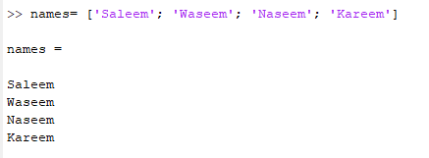

Example 1
Example 2

Slide 17
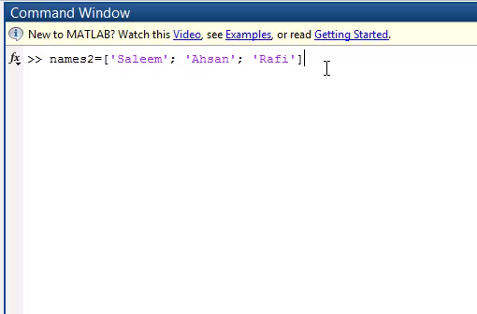
Example 2

Slide 18

Example 3

Slide 19
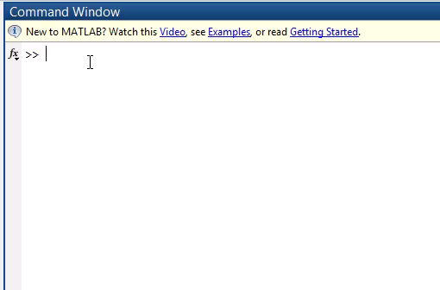
Example 4

Slide 20
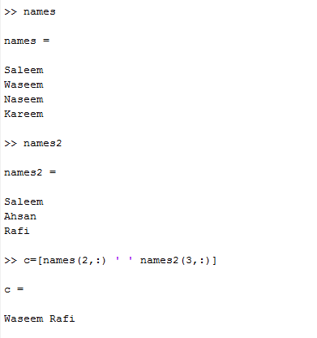
Manipulating character strings
Character strings can be manipulated just like matrices. Thus
c=[names(2,:) ‘ ‘ names2(3,:)] produces Waseem Rafi as the output variable in c.

Slide 21

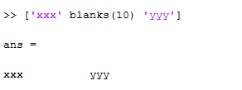

There are several built-in functions for character string manipulation

Slide 22
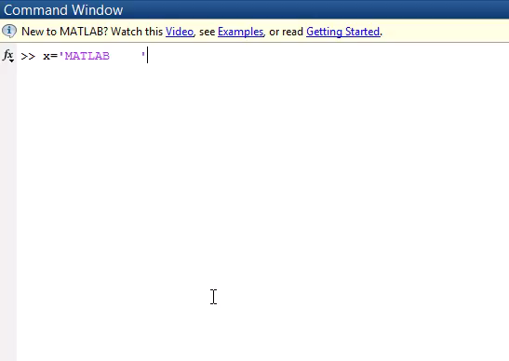
There are several built-in functions for character string manipulation

Slide 23
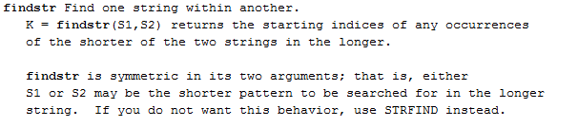
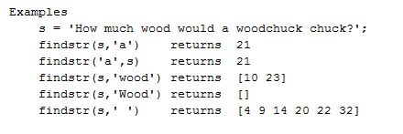
There are several built-in functions for character string manipulation

Slide 24
Thank you so much

